Slide 1
Hardware component testing 1
Submitted by
Amit Kumar
c0772515

Slide 2
Component’s Tested
Beaglebone Black Wireless
Xbee Module
Temperature sensor
Arduino uno
Digital Multimeter
DC Fan
Octocoupler

Slide 3
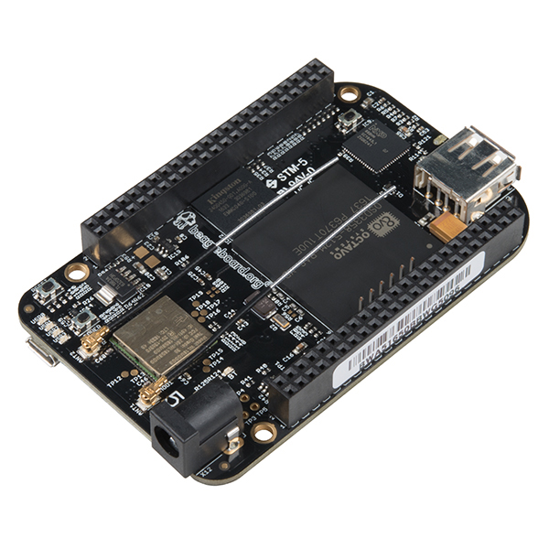
Testing BeagleBone Black wireless
Replacing the 10/100 Ethernet port with onboard 802.11 b/g/n 2.4GHz WiFi and Bluetooth, the popular open source BeagleBone Black computer now comes with built-in wireless networking capability.

Slide 4
Testing BeagleBone Black wireless
SPECFICTION:
Octavo Systems OSD3358 1GHz ARM® Cortex-A8
512MB DDR3 RAM
4GB 8-bit eMMC on-board flash storage
3D graphics accelerator
NEON floating-point accelerator
2x PRU 32-bit microcontrollers

Slide 5
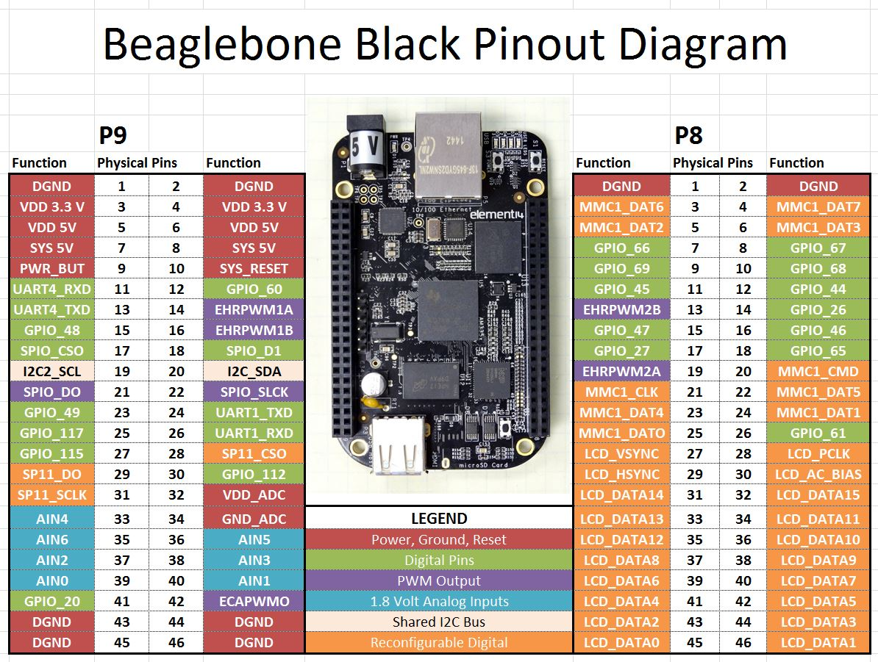
Pin description of BBB wireless

Slide 6
Testing BeagleBone Black wireless
Software:
Debian with Cloud9 IDE on Node.js w/ BoneScript library
Third party support for Android and Ubuntu
Connectivity
USB client for power & communications
USB host
802.11b/g/n and Bluetooth 4.1 plus BLE
HDMI
2x 46 pin headers

Slide 7
Testing BeagleBone Black wireless
Updating latest debian image in BBB
Methods used for communication between Beaglebone black and PC
Terminal
Putty
Cloud9 IDE

Slide 8
Updating latest debian (OS) image in BBB
BBB is supplied with a Linux distribution already on its eMMC, one of the first steps we may carry out is updating your BBB to have the latest Linux distribution.
Go to https://beagleboard.org/latest-images and download the latest Debian Image. Debian images are graphical or non-graphical. We can download as per our requirement as graphical image occupies more memory space on BBB, so we will go with non-graphical one.
It will be downloaded in .img.xz format and we can decompress using xz -d BBB*.xz command ,here BBB* is file name.
Now we need to download a flashing program such as Balena Etcher in our PC.

Slide 9
Updating latest debian (OS) image in BBB
After starting Etcher we will click on Select Image to get started.
Use the “Change” option under the Storage Media Column to select the SD Card we want to use.
After clicking on flash, flashing will get started.
Insert the SD Card into your BeagleBone Black Wireless.
Connected BeagleBone Black Wireless to computer using the MicroUSB Cable. Wait a few minutes for it to initialize and boot before proceeding to the next step.
Hold down the USER/BOOT button and now apply power, either by the USB cable or 5V adapter.

Slide 10
Updating latest debian (OS) image in BBB
When the flashing is complete, all 4 on-board LEDs will be steady on or off. The latest Debian flasher images automatically power down the board upon completion.
Power-down the board, remove the SD card and apply power again to finish.
Now latest image is downloaded and we can check it using command
uname -a

Slide 11
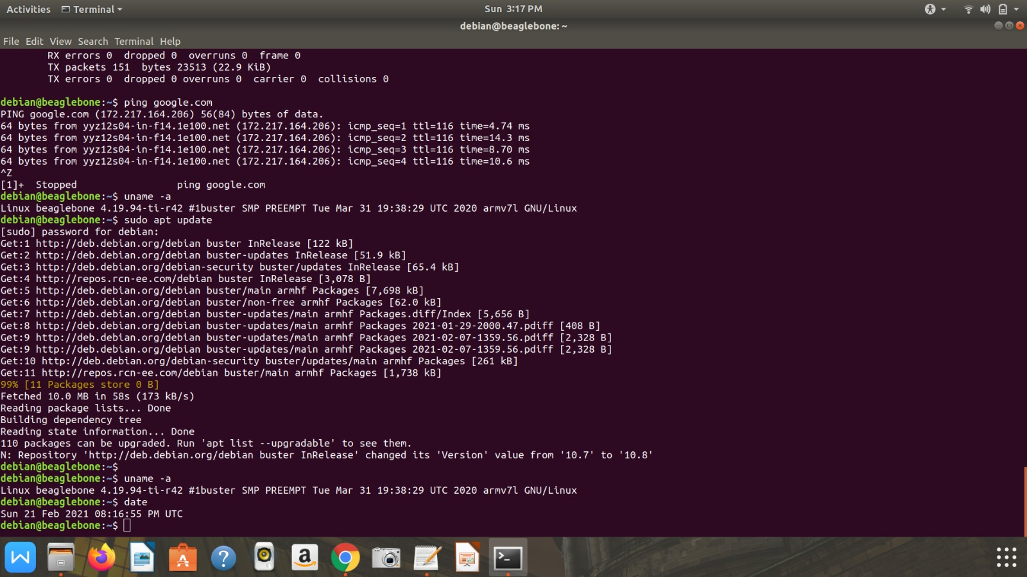

Slide 12
Testing BeagleBone Black wireless
Command for connecting BBB wireless through terminal
ssh debian@192.168.7.2
psftp debain@192.168.7.2

Slide 13
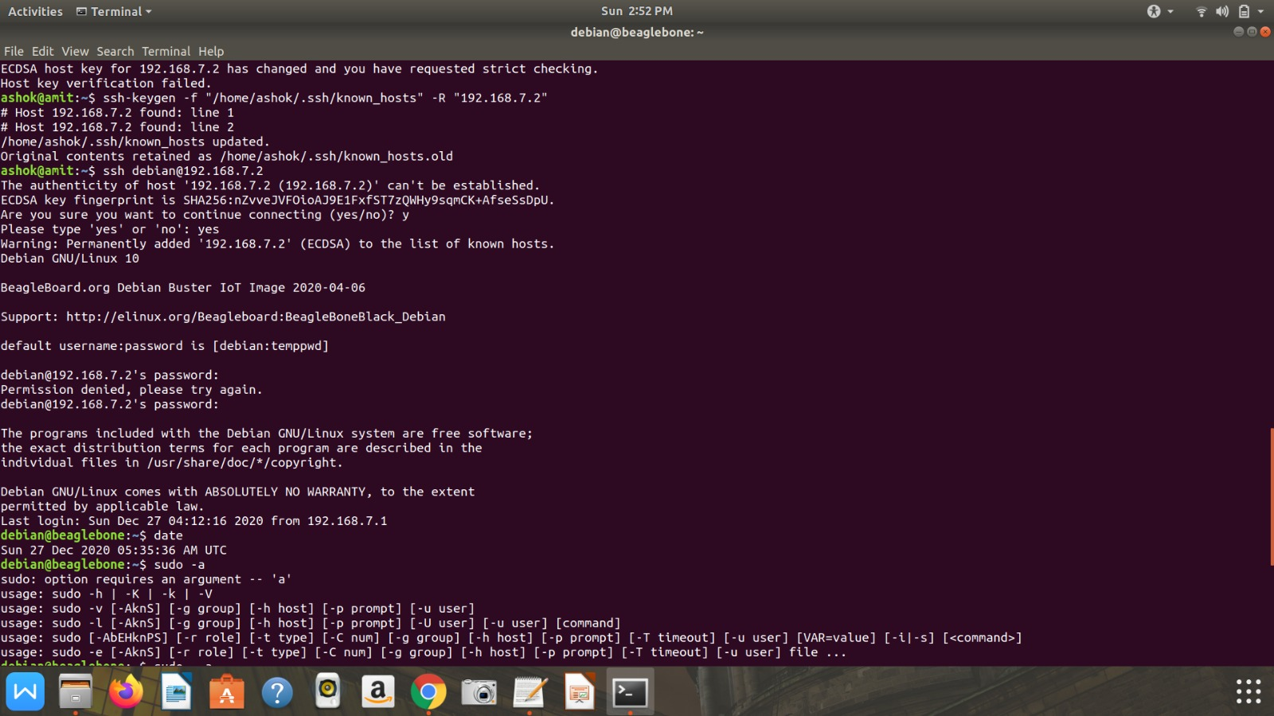

Slide 14
Cloud 9 Ide and putty ssh
Cloud9
Connect BBB wireless with PC using USB
Enter in browser http://192.168.7.2:3000
Putty
Enter 192.168.7.2 in host for putty application

Slide 15
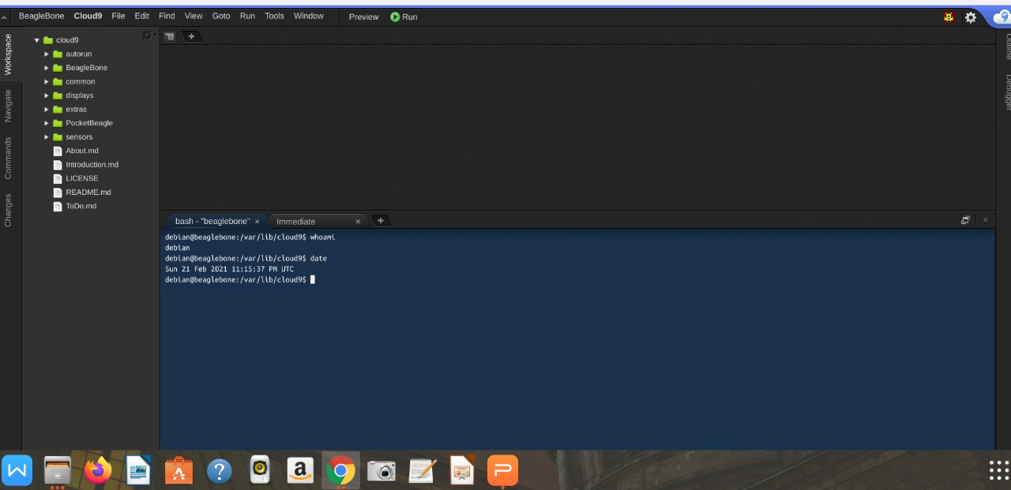

Slide 16
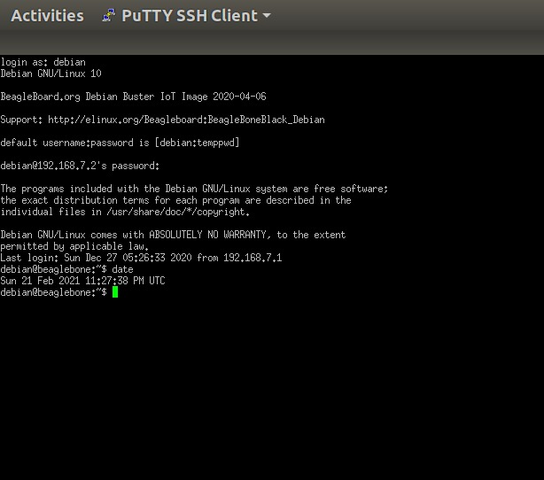

Slide 17
Testing BBB wireless:
Commands for Connecting to wifi through BBB
sudo connmanctl
enable wifi
scan wifi
Services
agent on
connect <wifi network name>
Enter Password
quit
ifconfig
Ping google.com

Slide 18
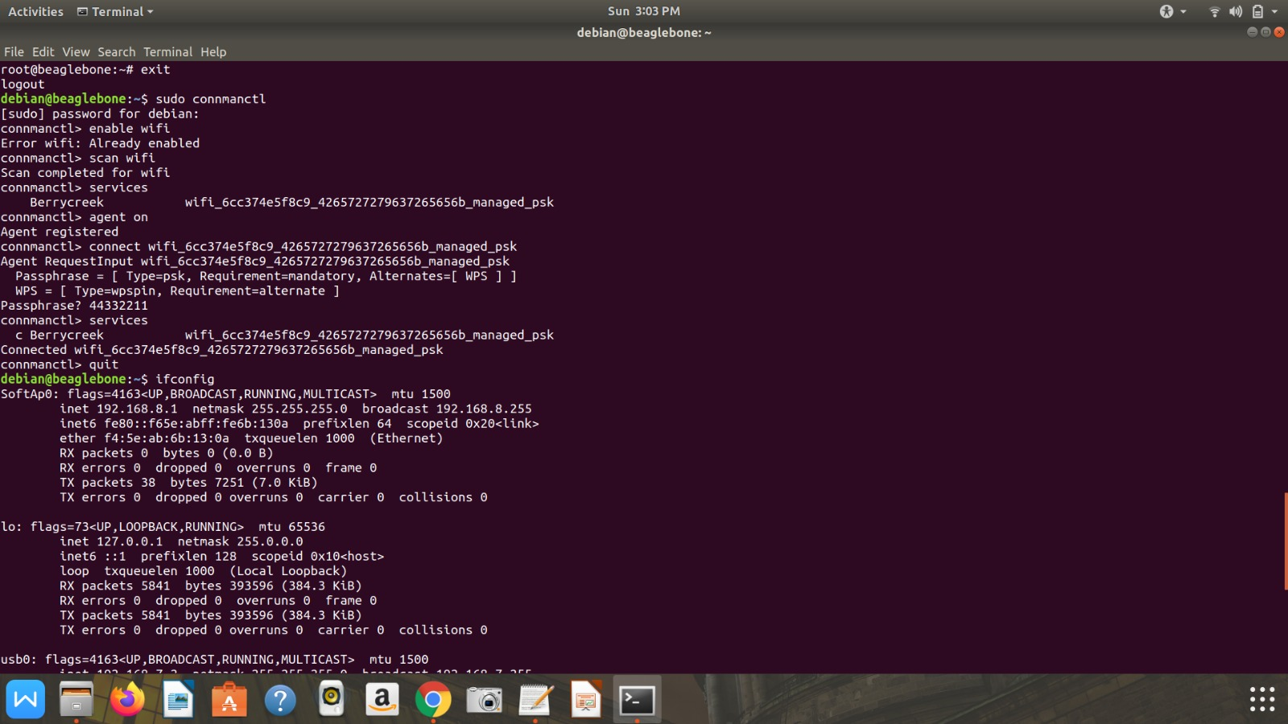

Slide 19
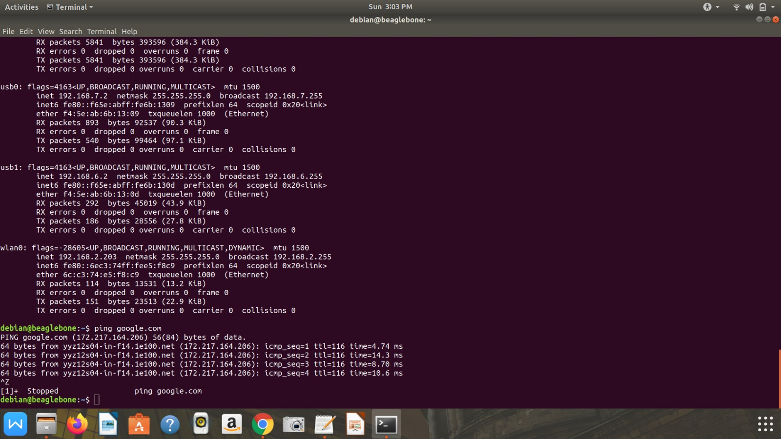

Slide 20


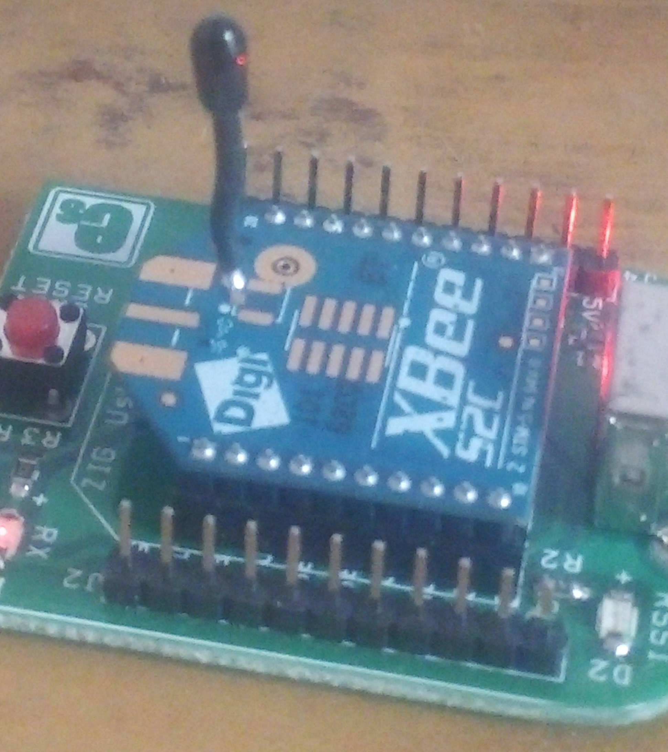
Testing Xbee S2c Module
Transmission Frequency: 2.4GHz to 2.5GHz
Operating Current: 33mA (at3.3V, for Normal mode) , 45mA (at 3.3V,for Boost mode)
RF Data Rate: 250,000 bps
This Photo by Unknown Author is licensed under CC BY-SA

Slide 21
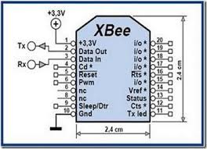
Testing Xbee S2c Module
Pin 1 to 3.3v pin of Arduino UNO
Pin 2 to TX of Arduino UNO
Pin 3 to Rx of Arduino UNO
Pin 10 to GND pin of Arduino UNO

Slide 22
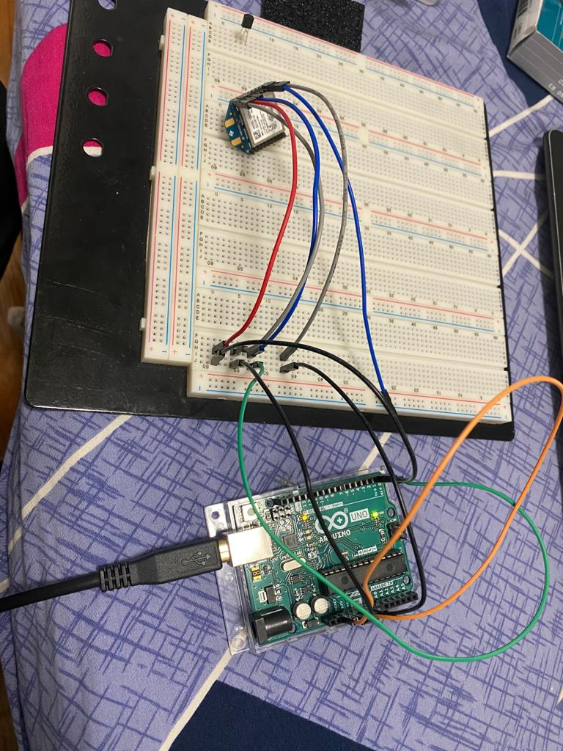

Slide 23
Software for Xbee
XCTU software is needed for testing and configuration of Xbee S2c module
XCTU is a free multi-platform application designed to enable developers to interact with Digi RF modules through a simple-to-use graphical interface. It includes new tools that make it easy to set-up, configure, and test XBee RF modules.
You can manage and configure multiple RF devices, even remotely (over-the-air) connected devices.

Slide 24
Software for Xbee
XCTU is a free, multi-platform application compatible with Windows, MacOS and Linux
Graphical Network View for simple wireless network configuration and architecture
API Frame Builder is a simple development tool for quickly building XBee API frames
Firmware Release Notes Viewer allows users to explore and read firmware release notes

Slide 25
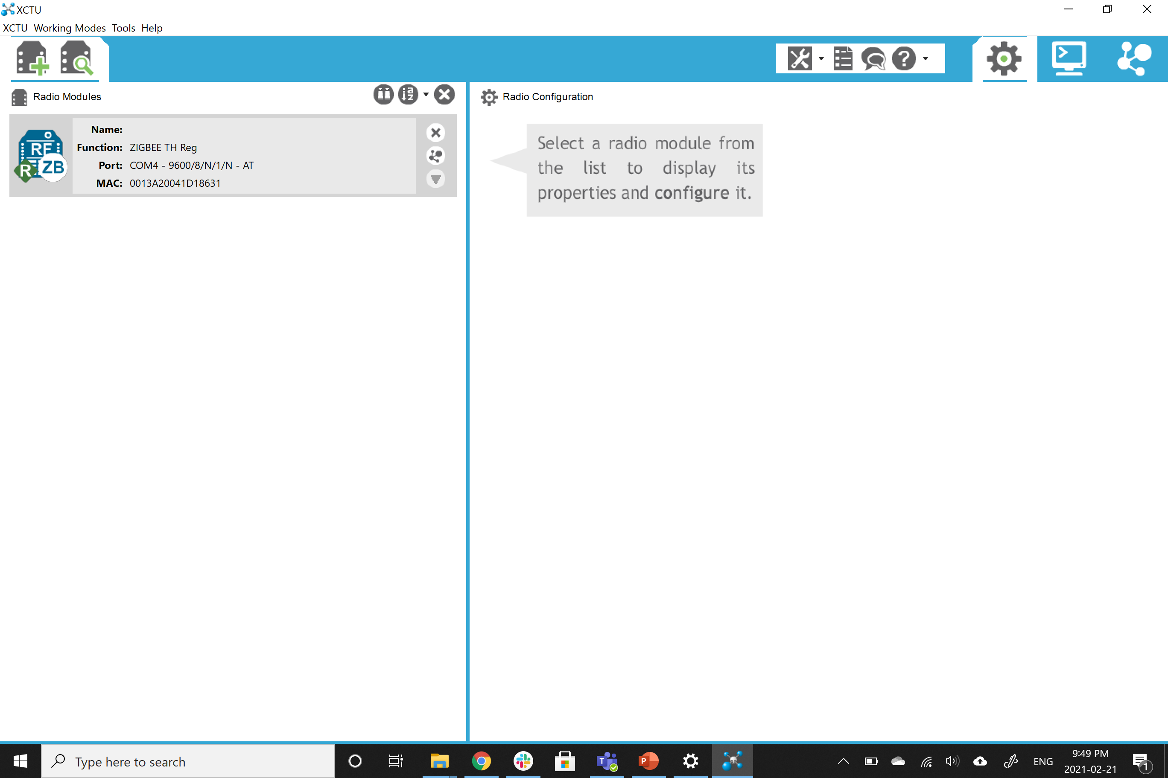

Slide 26
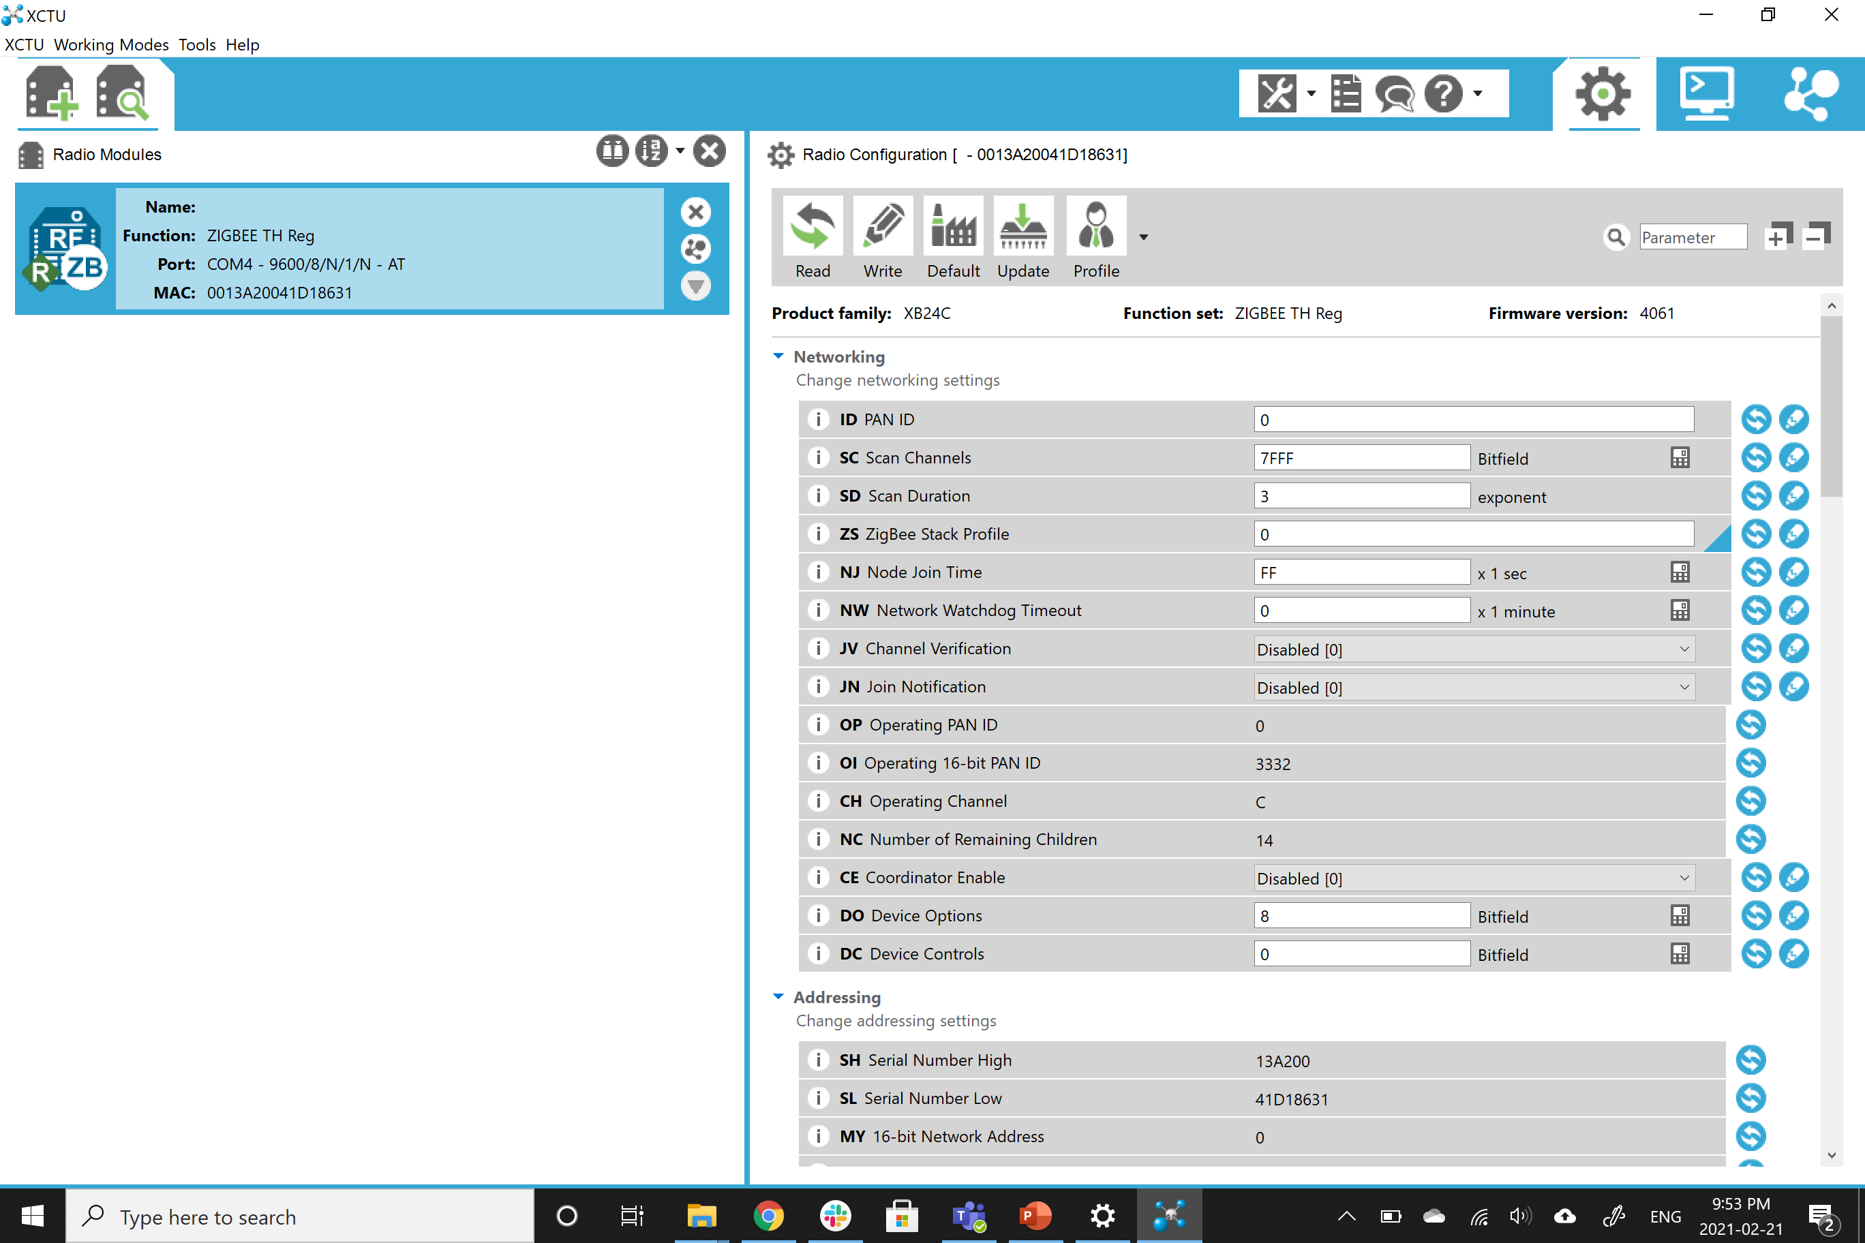

Slide 27
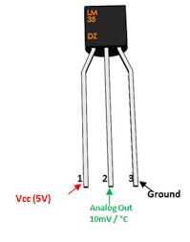
Temperature sensor

Slide 28

Temperature sensor internal circuit:

Slide 29
Testing Temperature sensor
Using Digital multimeter
Connect 5v and Gnd pin of LM35D to inputs voltage via beaglebone
Measure Vout using digital multimeter
T(in C)= Vout/10mV
In our case T= 252/10 =25.2 C

Slide 30
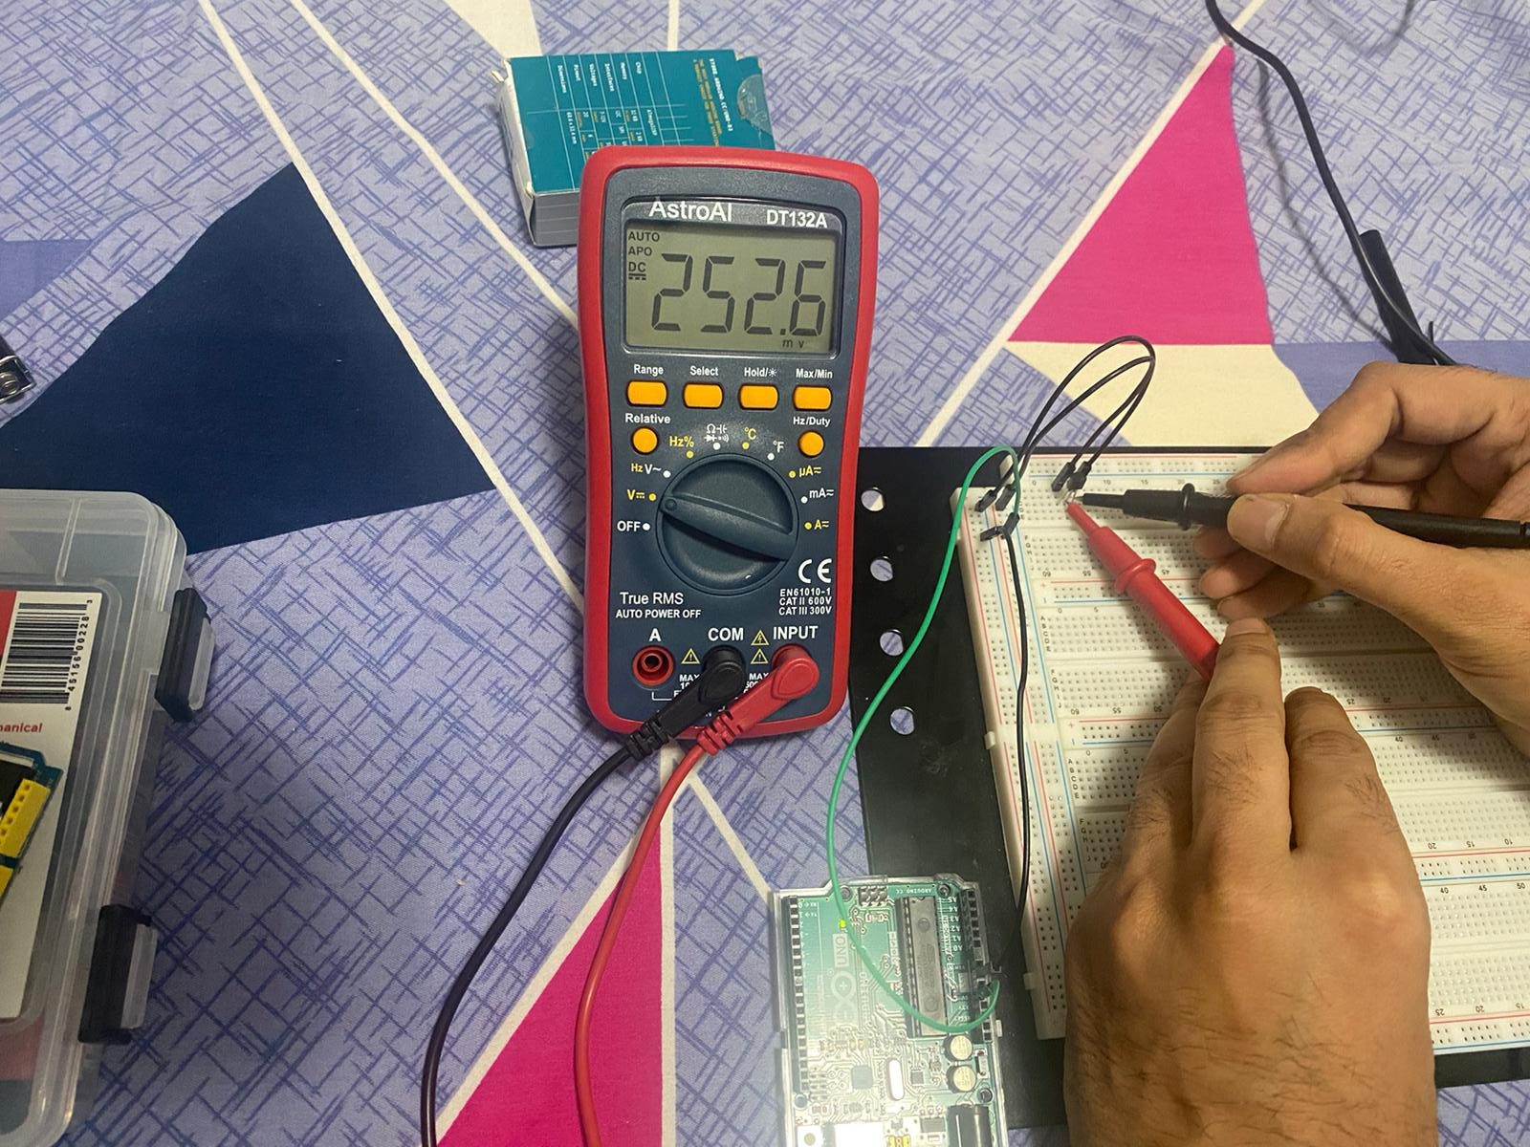

Slide 31
Testing Temperature Sensor
With previous connection add an LCD
Connect Vout to A0 of Arduino uno
Connect an LCD to PCF8574 I2C through Arduino UNO

Slide 32
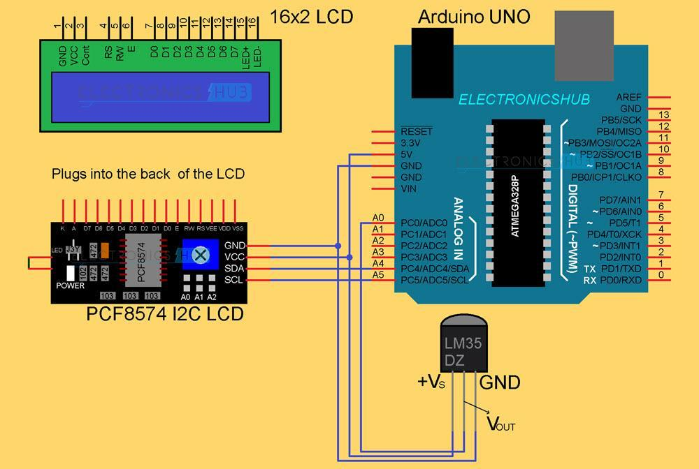

Slide 33
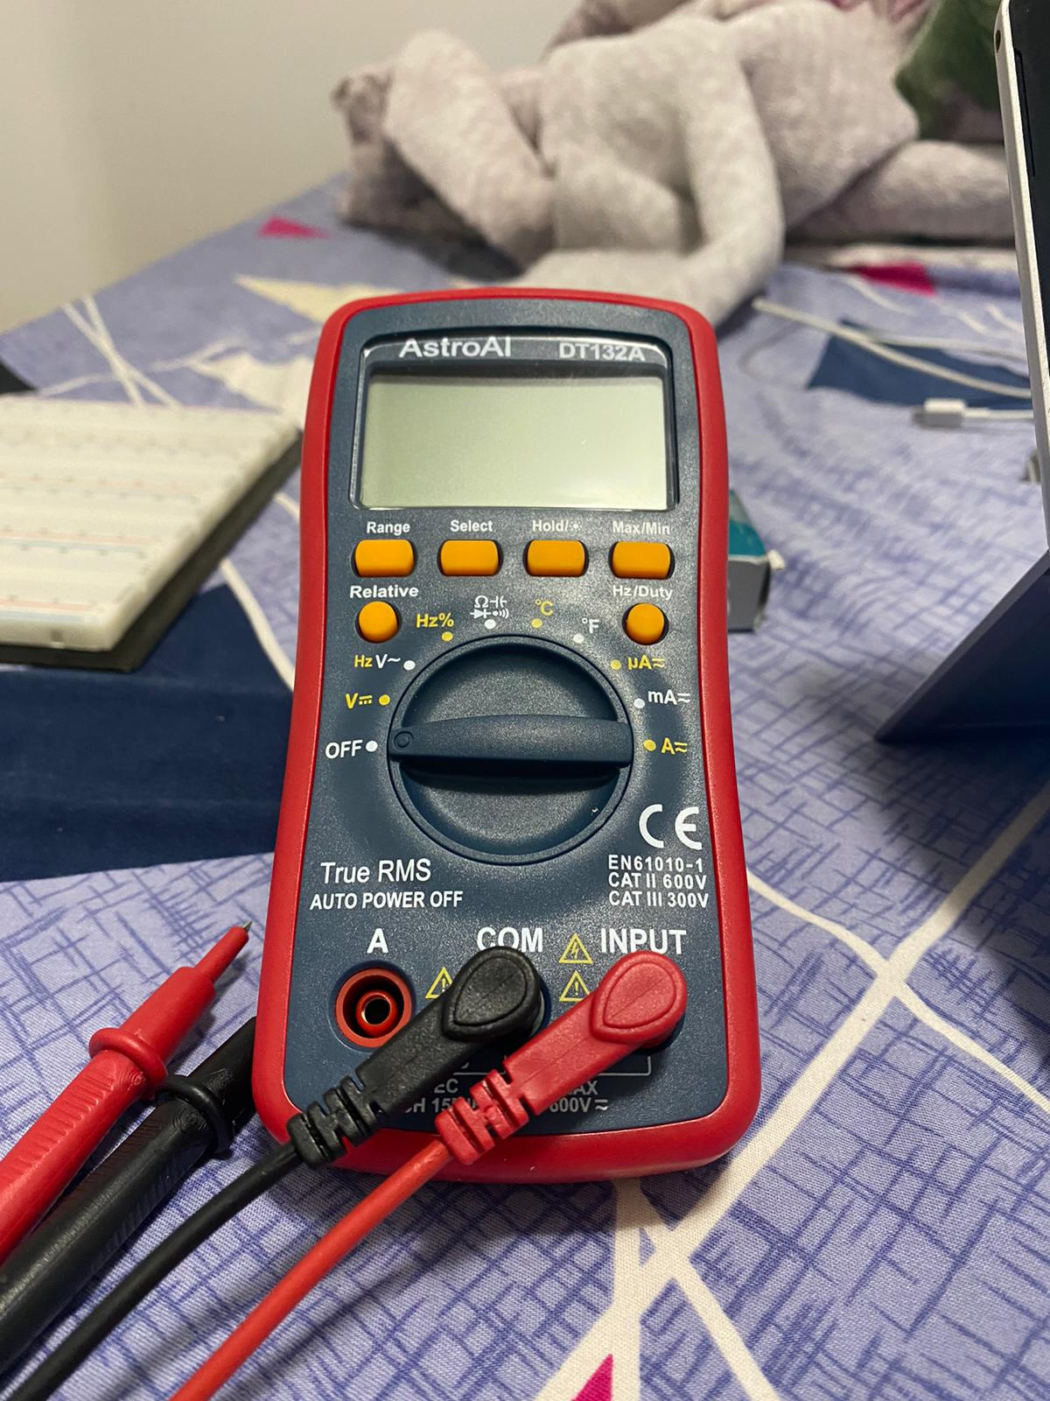
Digital Multimeter
A digital multimeter(DMM) is an important tool for testing, diagnosing, and troubleshooting electrical circuits, components, and devices. In electronics circuits, it is needed for checking following quantities:
To check output/input Voltage and Current
Resistance
Capacitance
Frequency
diode

Slide 34
Testing Of Digital Multimeter
Connect a Power source(9V)
Short circuit the Common and Input pins of Digital multimeter
Measure Resistance
Measure capacitance

Slide 35
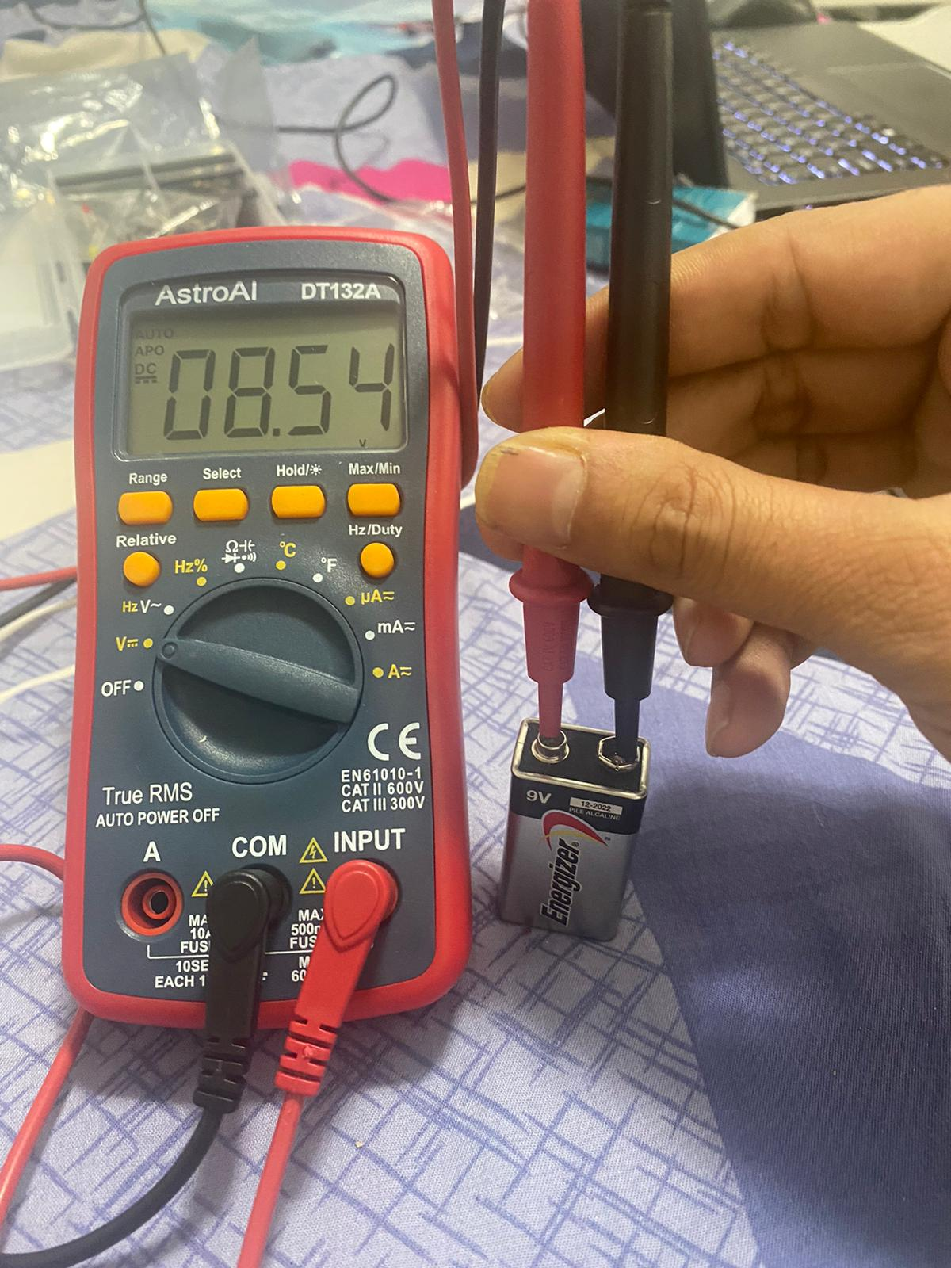
Testing Of Digital Multimeter: output

Slide 36
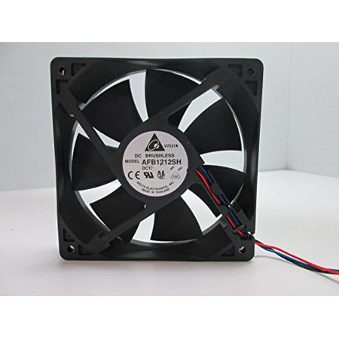
Testing Dc Fan:
It Contain the Dc motor
Need Power supply (9-12V)
The blades of fan rotate when connected to power supply.

Slide 37
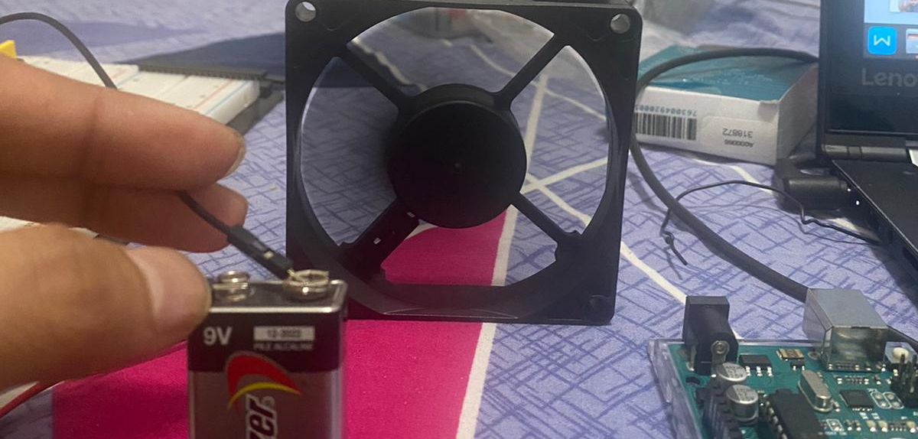

Slide 38
optocoupler:
An optocoupler or optoisolator, is a device that contains a light-emitting diode (LED) and a photosensor ( photodetector, such as a photoresistor, a photodiode, a phototransistor, etc. ). The purpose of an optocoupler is to transfer signals from one circuit to another yet keep them isolated.
MCT2E Features and Specifications:
Input Diode Forward Voltage: 1.25V
Collector-Emitter Voltage: 30V
On-State Collector Current: 5mA
Transistor HFE: 300
Rise Time: 5us
Fall Time: 5us
Available as 6-pin PDIP with and without M-suffix

Slide 39
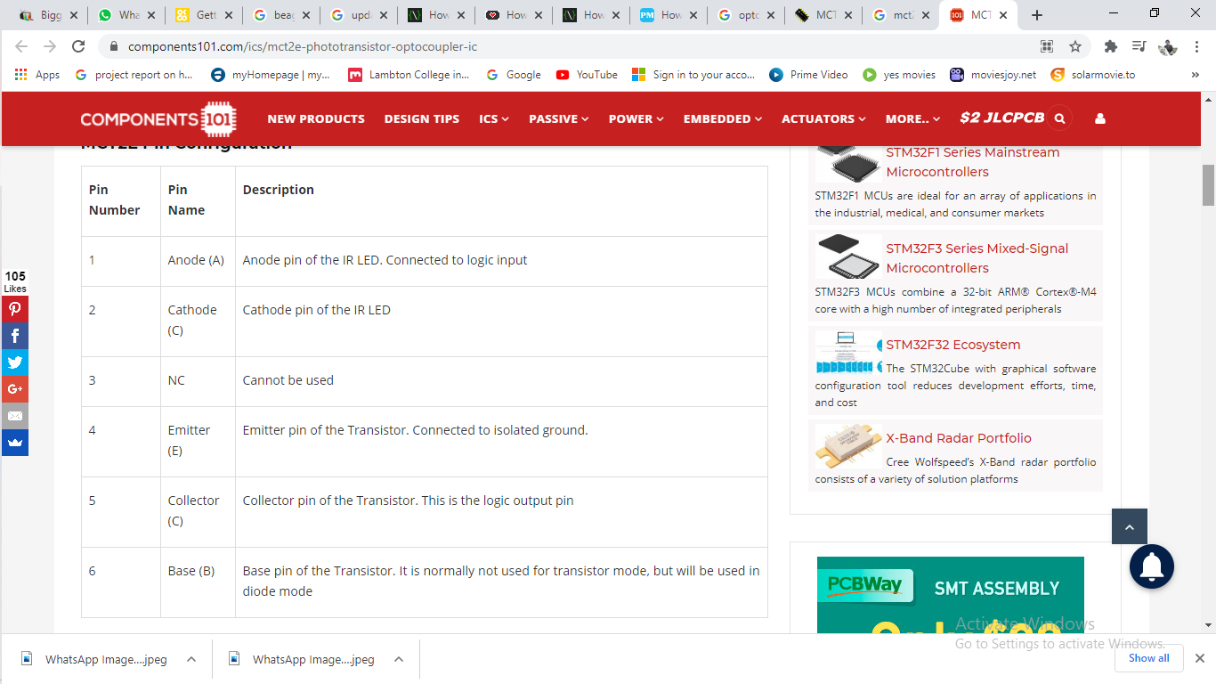
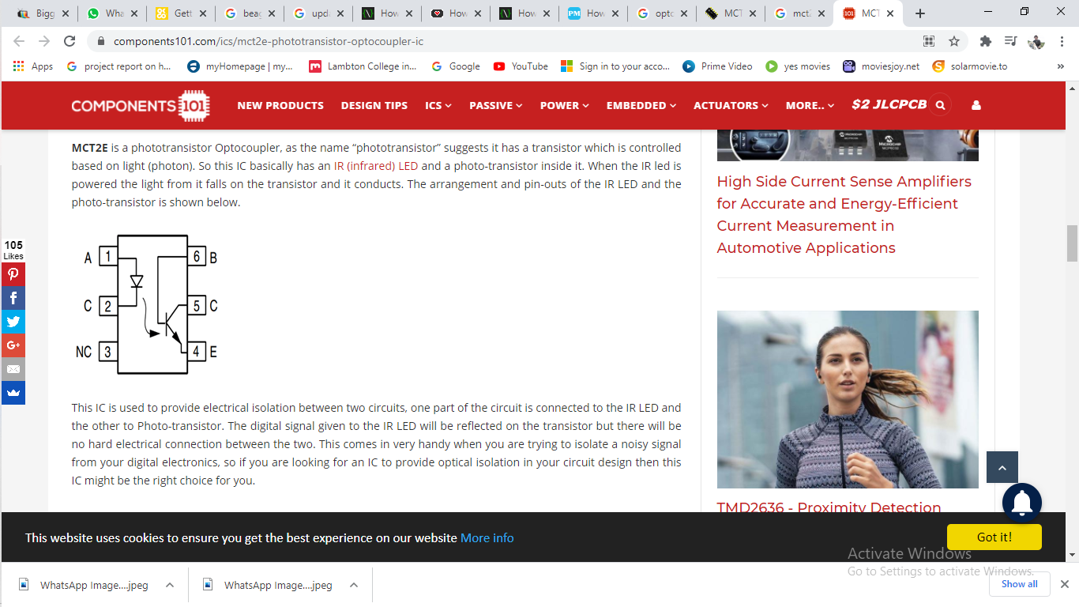
Pin description of optocoupler(McT2e):

Slide 40
Testing optocoupler:
We can test optocoupler using DMM set on the resistance domain.
Firstly, measure between pins 1(Anode) and 2(Cathode) and we get one reading measuring one way and no reading the opposite way (just like we check a diode).
If we get a value either way or no value at all, then certainly there is a problem with the LED, and we should find another optocoupler.

Slide 41
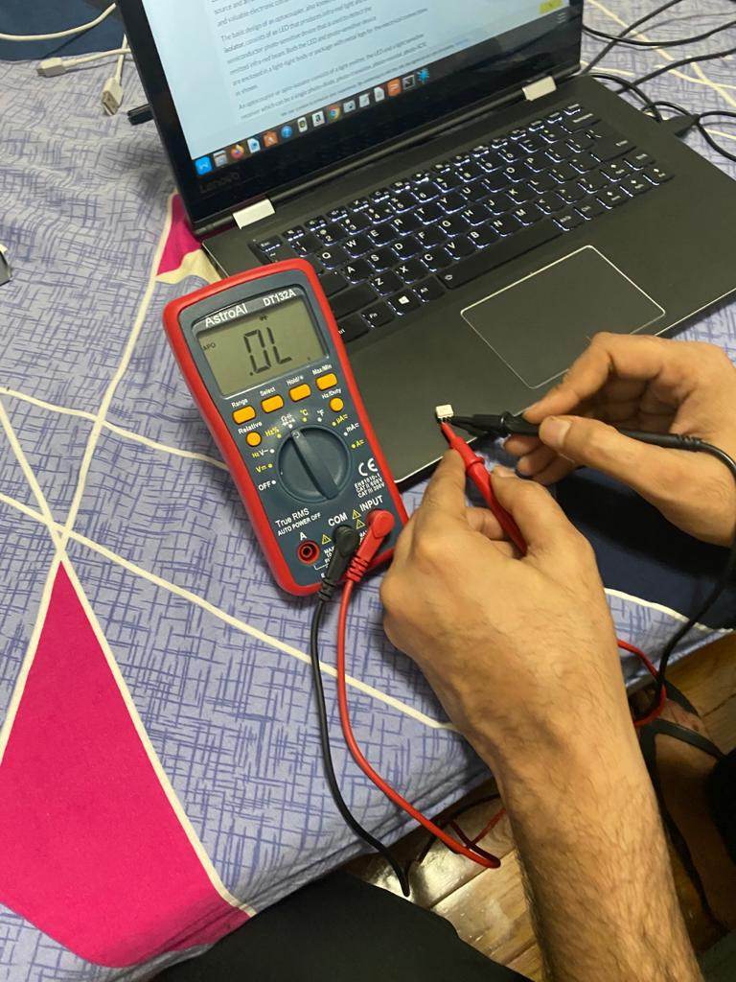
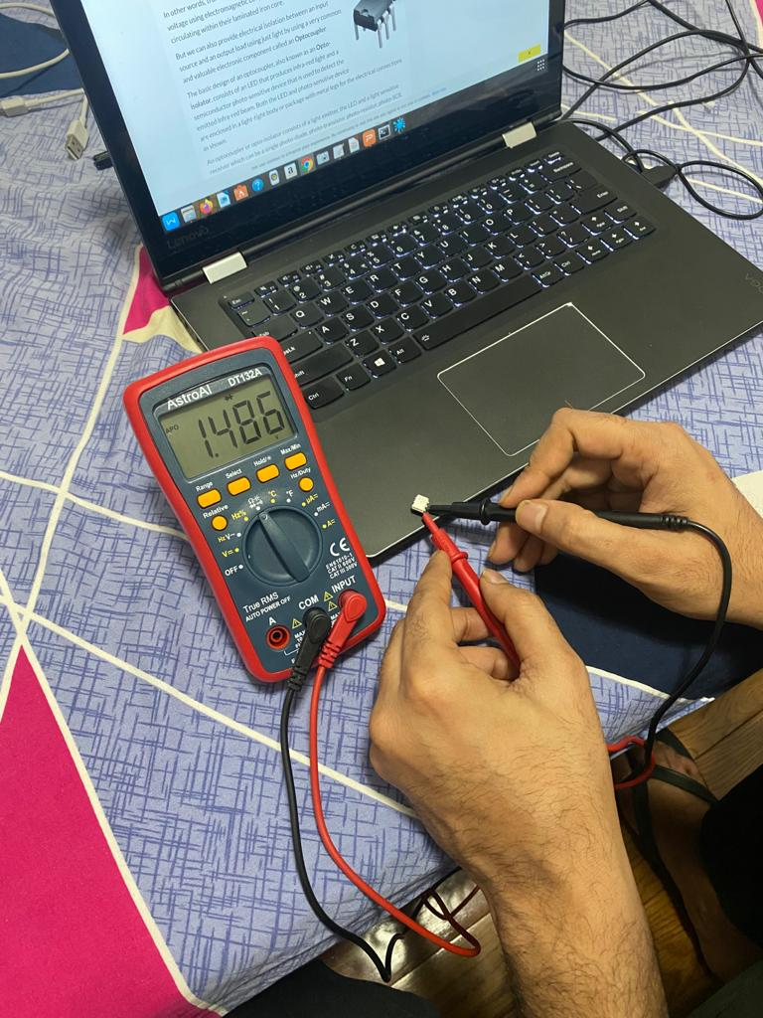
Testing optocoupler:
Reverse direction(reverse biasing)
Forward direction(forward direction)

Slide 42
Testing optocoupler: led side
After checking LED side, we should check the phototransistor.
We will connect DMM between pins 4 and 5 ( the emitter and collector ) and we should get a high resistance value both ways if the phototransistor is good.
If we get no reading at all, is probably because most phototransistors have such high resistance between emitter and collector that the ohmmeter can’t measure.

Slide 43
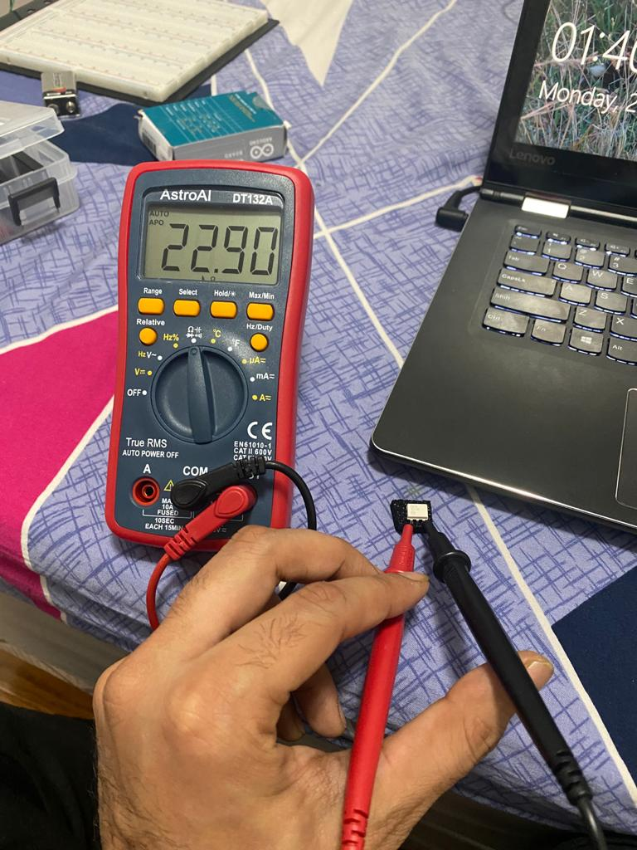
Testing optocoupler: phototransistor side

Slide 44

Questions?

Slide 45
References:
Beaglebone black features:
https://www.element14.com/community/roadTestReviews/2534/l/beaglebone-bundle-bbb-wireless-cape-display-review
Getting started with the Beaglebone black wireless:
https://www.okdo.com/project/getting-started-with-the-beaglebone-black-wireless/?ok_ts=1613940148046
http://derekmolloy.ie/write-a-new-image-to-the-beaglebone-black/#prettyPhoto
Temperature sensor internal circuit:
https://www.researchgate.net/publication/224377380_Smart_wireless_temperature_data_logger_using_IEEE_802154ZigBee_protocol/figures?lo=1
https://www.electronicshub.org/arduino-lm35-temperature-sensor/

Slide 46
References:
Xbee module testing
https://www.youtube.com/watch?v=cf3RLBg4t5s
https://components101.com/wireless/xbee-s2c-module-pinout-datasheet#:~:text=XBee%20S2C%20is%20a%20RF,including%20devices%20from%20other%20vendors
https://spin.atomicobject.com/2016/07/18/xbee-tutorial/

Slide 47
References:
Optocoupler features:
https://components101.com/ics/mct2e-phototransistor-optocoupler-ic
Testing optocoupler:
https://www.antimath.info/electro/how-to-test-an-optocoupler/
https://components101.com/ics/mct2e-phototransistor-optocoupler-ic

Slide 48

THanks

